Slide 1

Summary Time

Slide 2
Taco Paper
First of all, black and white visuals are gorgeous
Research Question – Using REASON, what besides the detection of the ocean can we use to constrain geophysical/geothermal properties of Europa?
Answer – Sparse echoes
Pore-curing
Eutectic melt
Unattributed echoes

Slide 3
Taco Paper
Pore Curing – Porous gaps in regolith decreasing with depth
Potentially detectable (Greenland Firn) as a decrease in background power over depth
Low-depth feature
Eutectic Melt – Melt near eutectic
Specific Eutectic - Sea Ice/Zolotov + Shock 2001 model result (237 +-1 K)
High-depth feature
Unattributed echoes – Can’t say if is Pore Curing/Eutectic melt/??
Could be anywhere
Take lowest depth, use to constrain ice shell depth

Slide 4
Questions for You
Chance of positive identification?
How is detection of specific features of a radargram performed in radio glaciology?
What’s the difference between the detection of the eutectic melt and the “eutectic zone” that you want me to analyze?

Slide 5
Kalousova Paper
Varied 5 variables
𝜂₀ – Melting point Viscosity (PaS), ref 10^14 PaS
E_{a} – Activation Energy (J/mol), ref 5 * 10^4 J/mol
T_{s} – Surface Temp (K), ref 100 K
H_{m} – Magnitude of Volumetric Heating (W/m^3), ref 0 /m^3
D - Ice shell depth (km), no ref

Slide 6
Parameter variation Takeaway
Largest control for convective vigor
Melting point viscosity (10^13 Pa s - 10^15 Pa s ),
Activation Energy (2.2 *10^4 J/mol – 6.6 * 10^4 J/mol)
Ice shell depth (5 – 30 km)
Smaller controls
Surface Temp
Volumetric Heating

Slide 7
Important Comparisons

Slide 8
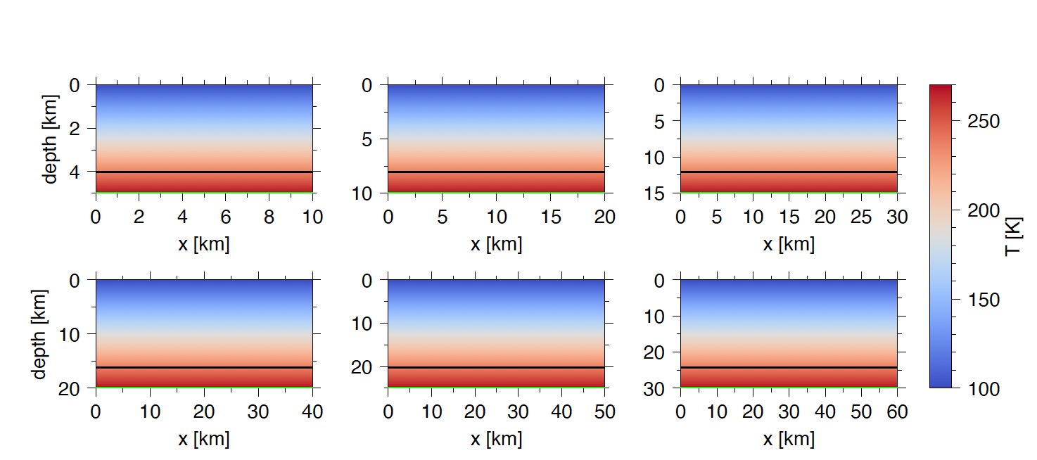
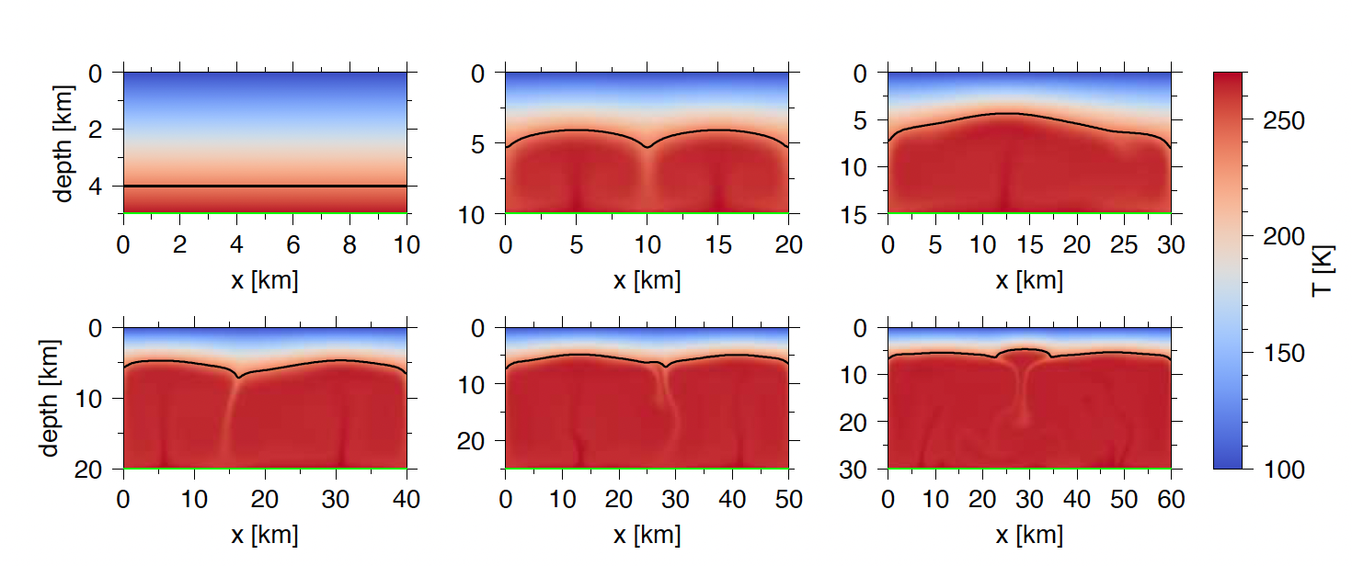
Sim set description
High melting point viscosity (10^15 Pa s)
Ref activation energy
No volumetric heating
Ts = 100 K
Description
Very conductive – so far the largest control of convective vigor is melting point viscosity
even more so then ice shell depth

Slide 9
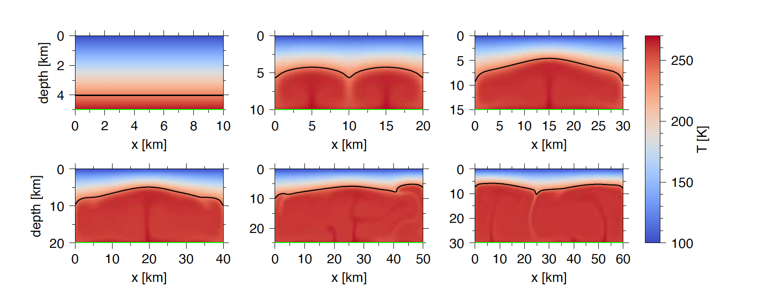
Sim set description
Lower N0 (melting point viscosity), 10^14 Pa s-> 10^13 Pa s
Ref activation energy
No volumetric heating
Ts 100 K
Description
Convection forms very early, 5 km – 10 km
First instance of vigorous convection/unstable plumes > 20 km

Slide 10
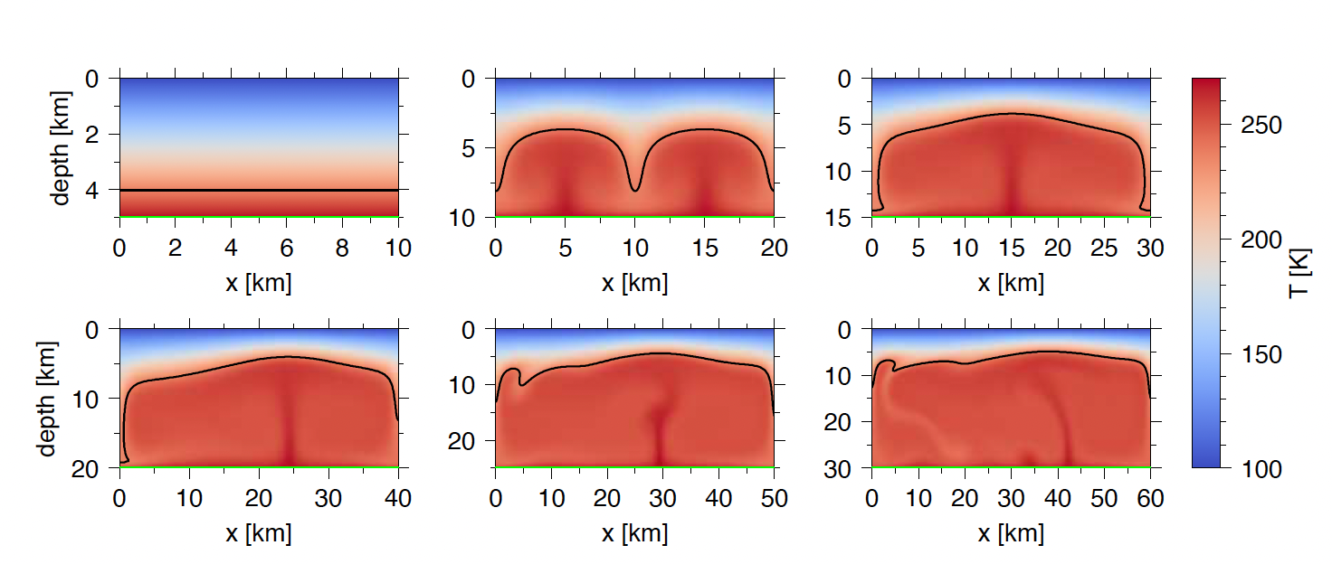
Sim set description
Reference melting point viscosity
Low activation energy
Ts = 100 K
No volumetric heating
Description
Low activation energy means viscous material can convect in smaller ice shells
Two small convection cells -> 1 big convective cell at larger depths

Slide 11
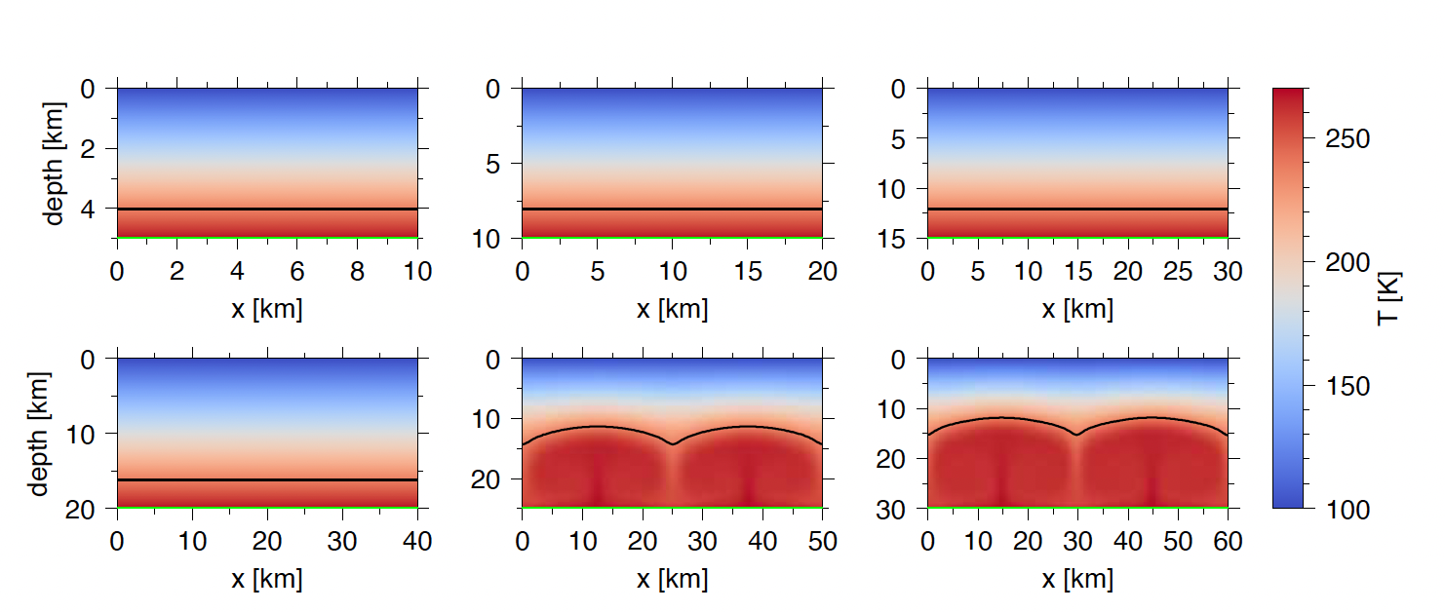
Sim set description
Ref melting point viscosity
high activation energy
Ts = 100 K
No volumetric heating
Description
Ref viscosity + high Ea means later convective transition than with ref Ea
Late convection, > 20 Km

Slide 12
My Pitch

Slide 13
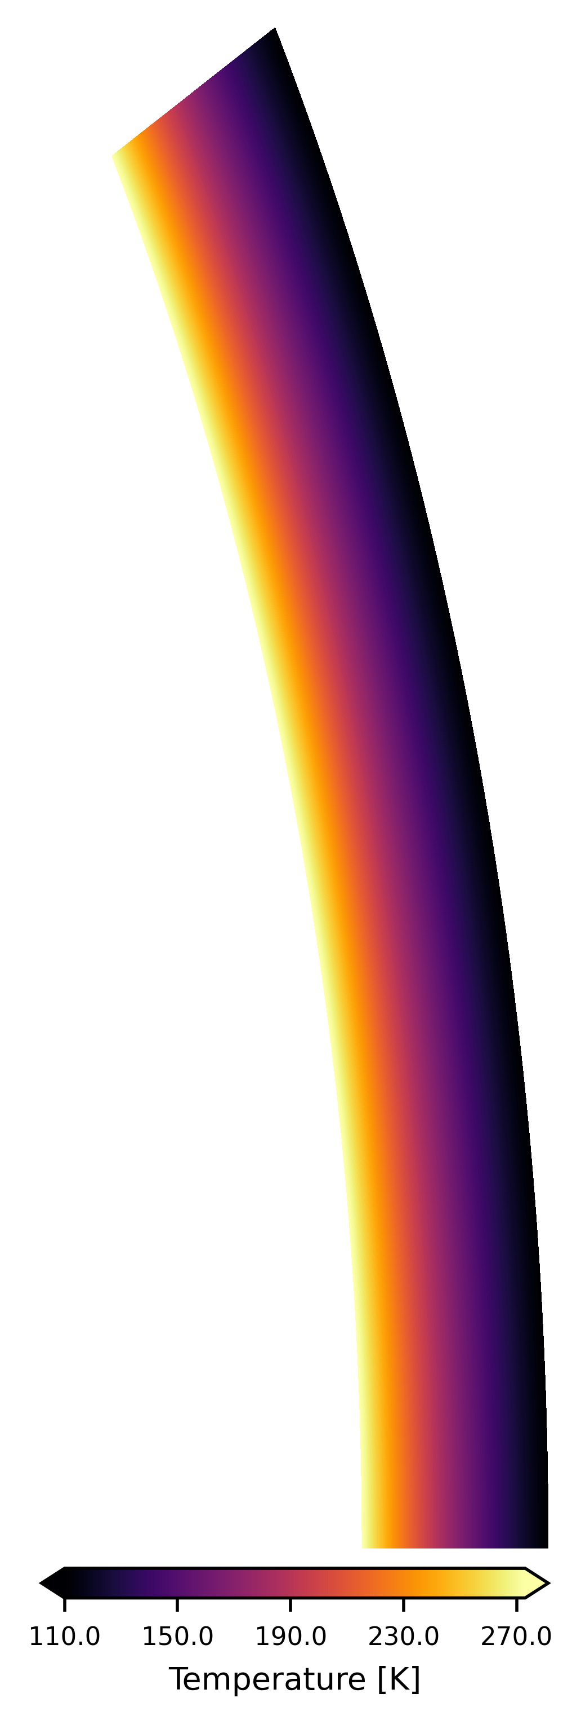
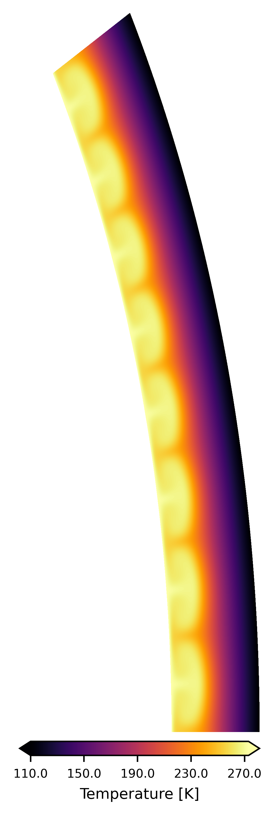
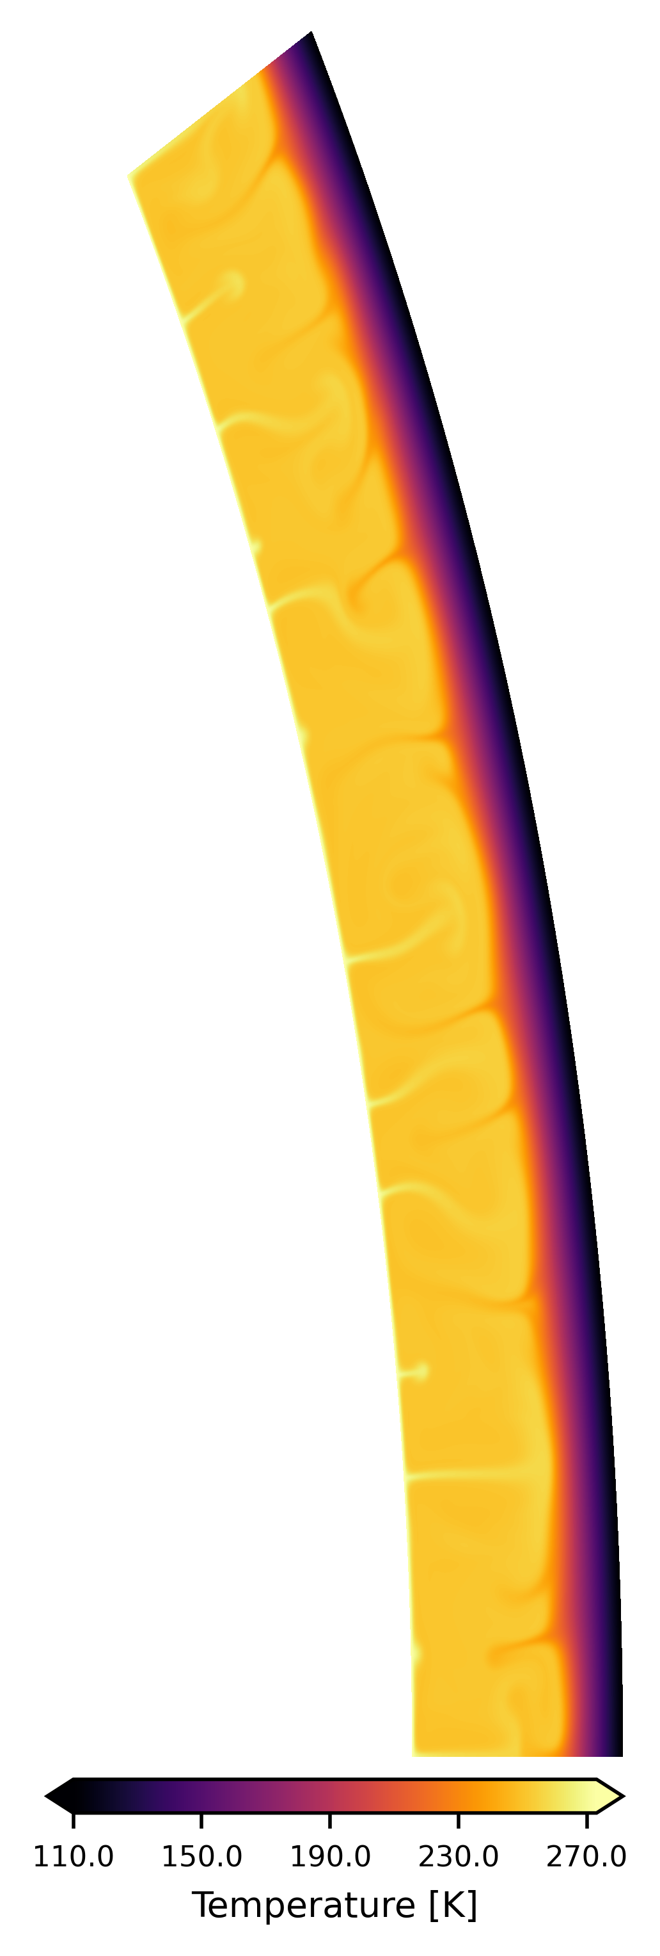
Conductive
Convective
Vigorously Convective

Slide 14
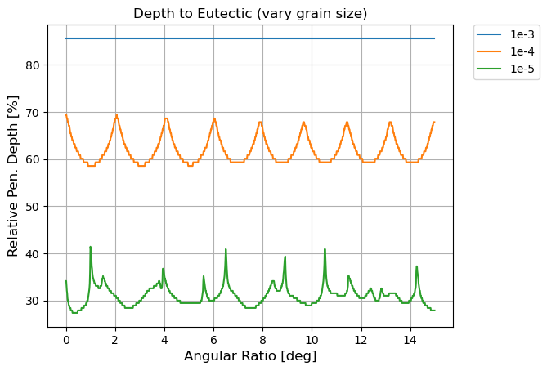
Conductive
Convective
Vigorously Convective

Slide 15
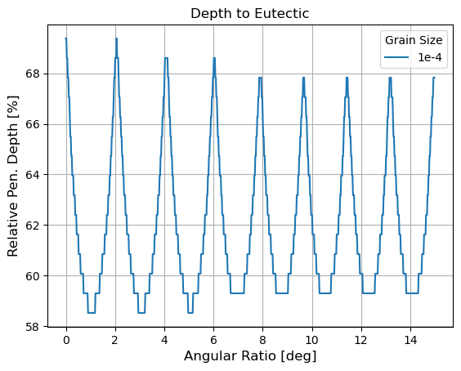
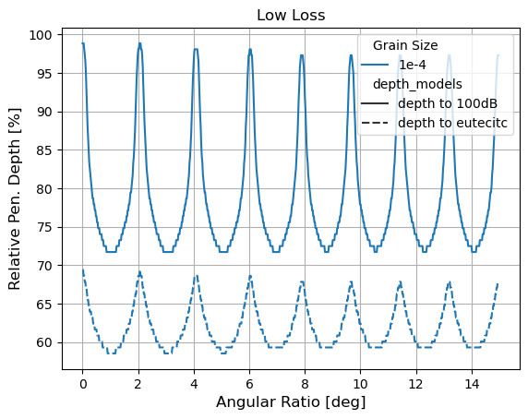
My pitch
Get simulations from GAIA
Accurately turn the ”depth to eutectic” patterns into “sparse echoes”
Starting point
Can you predict convective vigor from sparse echo of the eutectic melt?
Conductive
Convective
Vigorously Convective
Key parameters used for prediction
*Average depth to eutectic
*Eutectic pattern
Flat line
Symmetrical
Chaotic

Slide 16
My Pitch
Conductive
Convective
Vigorously Convective
Grain size ?
Ea?
Viscosity?

Slide 17
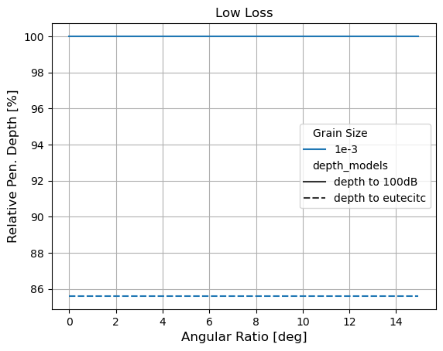
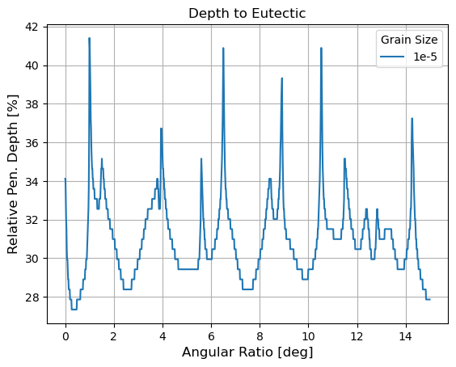
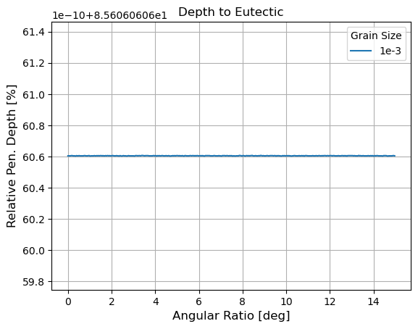
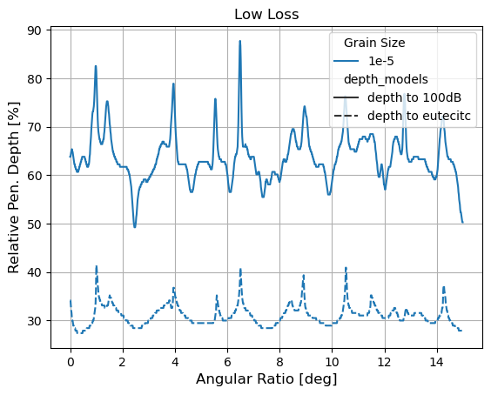
Conductive
Convective
Vigorously Convective

Slide 18
All Comaprisons

Slide 19
Kalousova Paper
Varied 5 variables
𝜂₀ – Melting point Viscosity (PaS), ref 10^14 PaS
E_{a} – Activation Energy (J/mol), ref 5 * 10^4 J/mol
T_{s} – Surface Temp (K), ref 100 K
H_{m} – Magnitude of Volumetric Heating (W/m^3), ref 0 /m^3
D - Ice shell depth (km), no ref

Slide 20
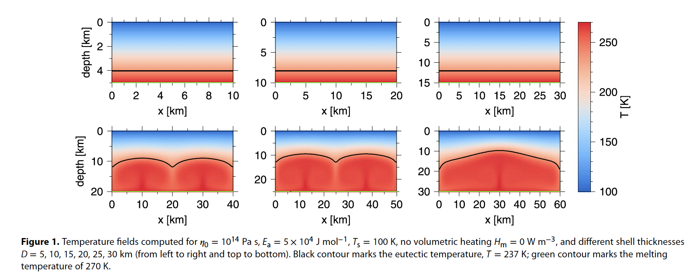
Sim set description
Vary ice shell depth (5-30 km)
No volumetric heating
Behavior change
Conductive shell until D > 15
Large shell leads to single plumes fusing/larger convective cells
Straight line vs. symmetrical pattern
Eutectic zone increases if convective with increasing ice shell depth

Slide 21
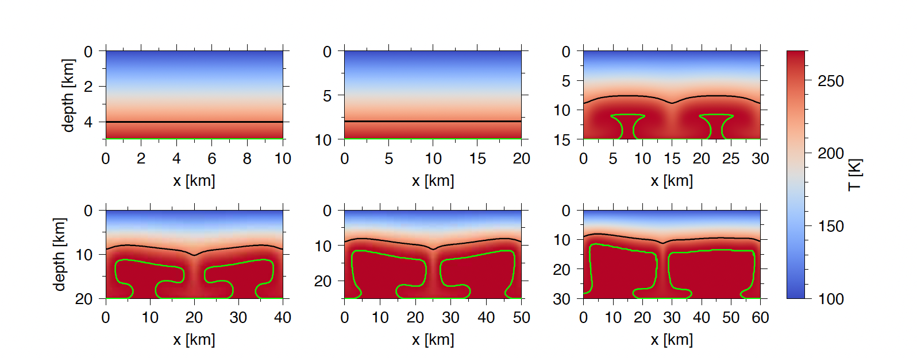
Sim set description
Same as before, but with Volumetric Heating
Behavior change
With Volumetric heating, convection forms earlier (5-15 km)
Symmetry vs Flat line still, but symmetry ruined by volumetric heating
Still a decrease in depth to eutectic with increasing ice shell thickness

Slide 22
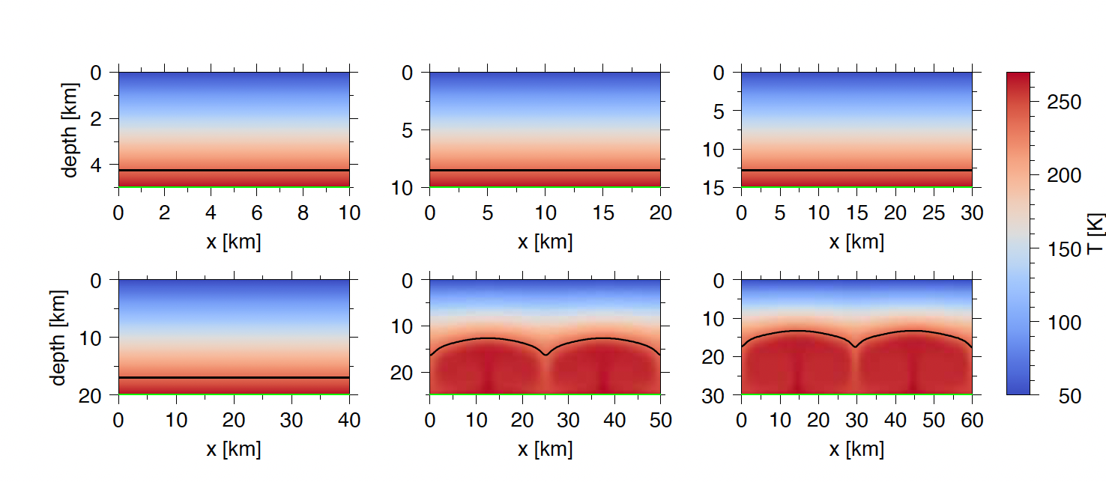
Sim set description
No volumetric heating
Ts 50 K
Behavior change
More conductive
Decreases rate of increasing eutectic depth with ice shell depth
Plume fusion likely >> 30 Km

Slide 23
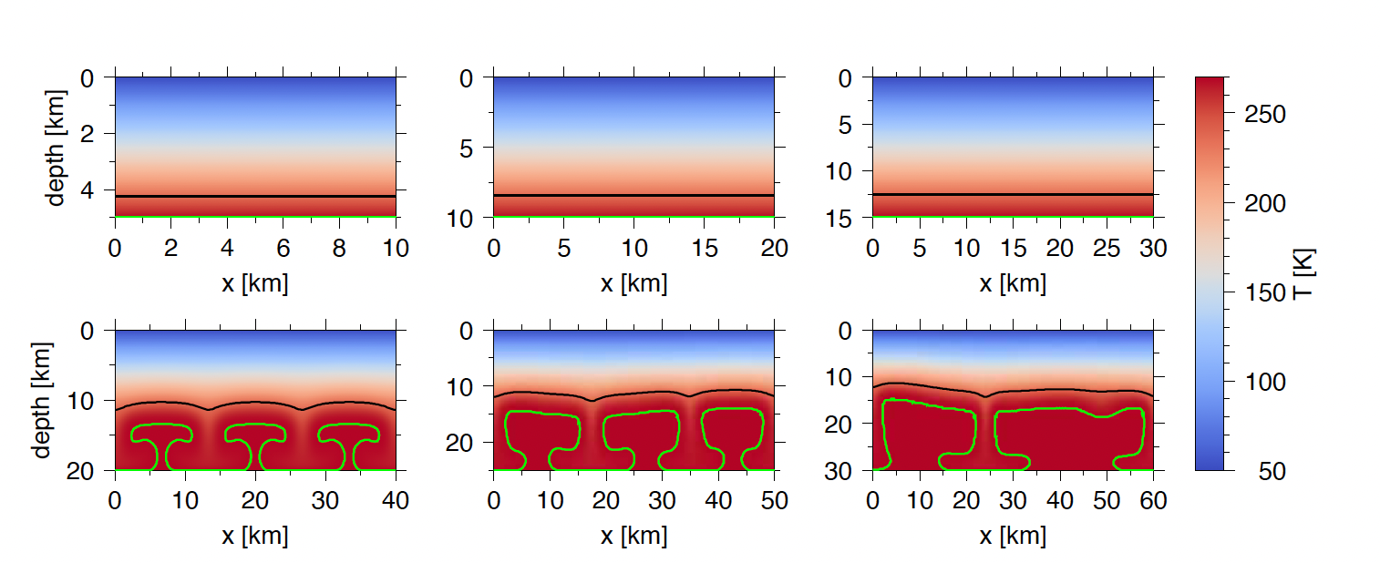
Sim set description
Ts = 50 k
With volumetric heating
Description
Volumetric heating causes convection to appear at smaller ice shell depths
3 cell convection in a 50 km span instead of 2
Increasing ice shell depth increases convective cell size, but decreases convective cell frequency

Slide 24
Sim set description
Lower N0 (melting point viscosity), 10^14 Pa s-> 10^13 Pa s
No volumetric heating
Ts 100 K
Description
Convection forms very early, 5 km – 10 km
First instance of vigorous convection/unstable plumes > 20 km

Slide 25
Sim set description
Low Melting point viscosity
With Volumetric heating
Behavior change
Volumetric heating decreases depth to eutectic (significant decrease relative to ice shell depth)
Two plume -> One plume -> two plume

Slide 26
Sim set description
High melting point viscosity (10^15 Pa s)
No volumetric heating
Ts = 100 K
Description
Very conductive – so far the largest control of convective vigor is melting point viscosity
even more so then ice shell depth

Slide 27
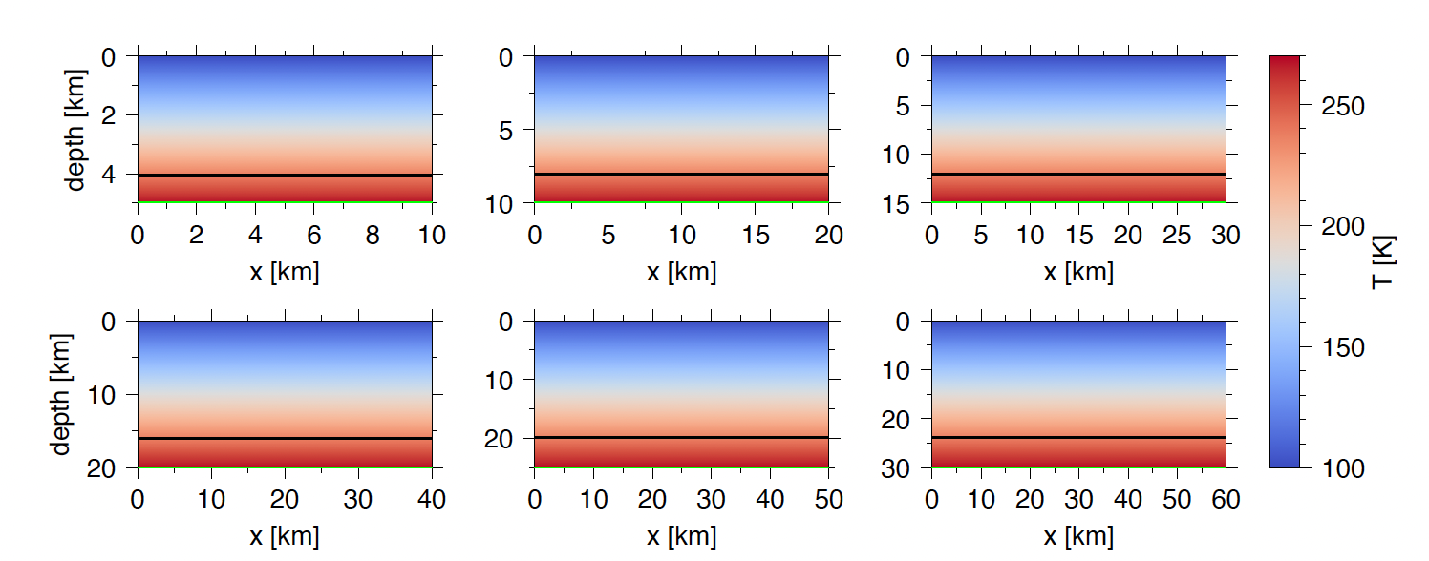
Sim set description
High melting point viscosity
Has volumetric heating
Ts = 100 K
Description
Volumetric heating did not sway simulation to become convective
Melting point viscosity too high

Slide 28
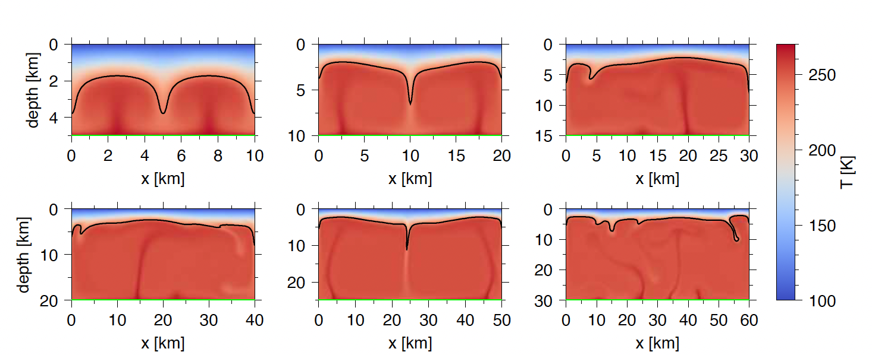
Sim set description
Low melting point viscosity
Low activation energy
Ts = 100 K
No volumetric heating
Description
Low activation energy allows convection to form very quicky (<= 5km)
Two convective cells, both unstable

Slide 29
Sim set description
Reference melting point viscosity
Low activation energy
Ts = 100 K
No volumetric heating
Description
Low activation energy means viscous material can convect in smaller ice shells
Two small convection cells -> 1 big convective cell

Slide 30
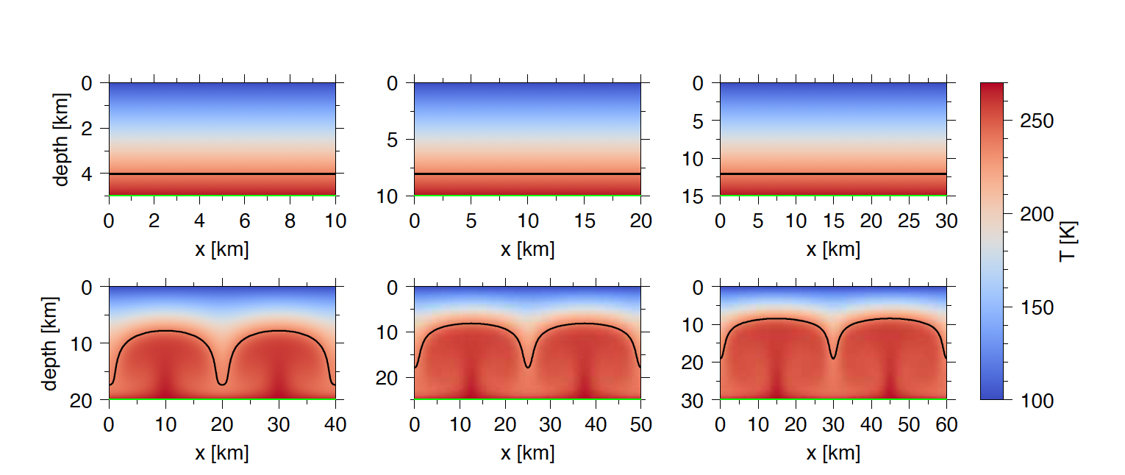
Sim set description
High melting point viscosity
Low activation energy
Ts = 100 K
No volumetric heating
Description
Low Ea means can convect even in very high viscosity, starting at > 15 Km
Stable 2 plume

Slide 31
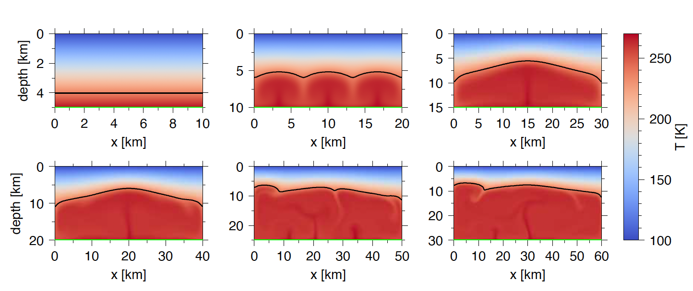
Sim set description
Low melting point viscosity
High activation energy
Ts = 100K
No volumetric heating
Description
Low viscosity + high Ea means stable convection in small ice shell depths, not in large
Unstable > 20 Km

Slide 32
Sim set description
Ref melting point viscosity
high activation energy
Ts = 100 K
No volumetric heating
Description
Ref viscosity + high Ea means later convective transition than with ref Ea
Late convection, > 20 Km

Slide 33
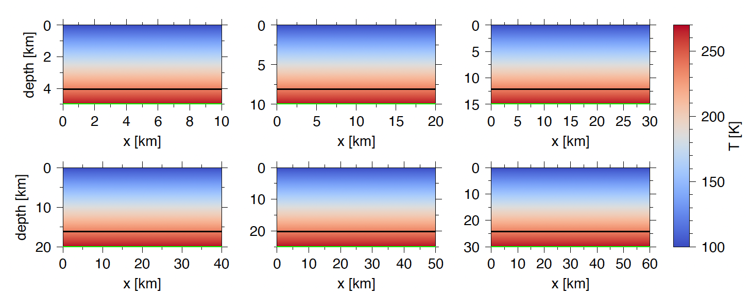
Sim set description
High melting point viscosity
High activation energy
Ts = 100 K
No volumetric heating
Description
High viscosity + high activation means no convection till probably > 45 km
d

